Slide 1
Psychology Chatbot
Submitted in the partial fulfillment for the award of the degree of
BACHELOR OF ENGINEERING
IN
CSE-AIML
Submitted by:
Sukhminder Singh 21BCS8221
Manish Kumar Yadav 21BCS10262
Tanmay Mitra 21BCS6712
Ashish Sharma 21BCS10436
Under the Supervision of:
Mrs. Lata Gupta
Department of AIT-CSE
DISCOVER . LEARN . EMPOWER

Slide 2
Outline
Introduction to Project
Problem Formulation
Objectives of the work

Slide 3
Introduction
In an era marked by technological advancements, psychology chatbots provide an innovative avenue for addressing mental health concerns, offering accessible and immediate support.
It is an artificial intelligence-driven virtual agent designed to engage users in conversations related to psychological well-being.
The anonymity offered by bots can encourage open communication about sensitive topics, potentially reducing the stigma associated with seeking help.

Slide 4
Problem Formulation
Dialogue Management: Can the chatbot maintain a coherent conversation flow, adapt to diverse user responses, and avoid repetitive or generic replies?
Emotional Intelligence: Can the chatbot respond with empathy, understanding, and non-judgmental support, mimicking the qualities of a human therapist?
Safety and Ethics: How can the chatbot ensure user data privacy, prevent misuse of information, and avoid generating harmful or misleading responses?

Slide 5
Objectives of the Work
To improve accessibility to mental health support by creating a chatbot that offers immediate and 24/7 availability for individuals seeking information, guidance, or assistance with psychological well-being.
To mitigate the stigma associated with discussing mental health issues by fostering open and non-judgmental conversations through the chatbot, encouraging users to express their concerns without fear of societal judgment.
To implement natural language processing and sentiment analysis to enable the chatbot to recognize and adapt its responses based on users' emotional states, creating a dynamic and personalized interaction.

Slide 6
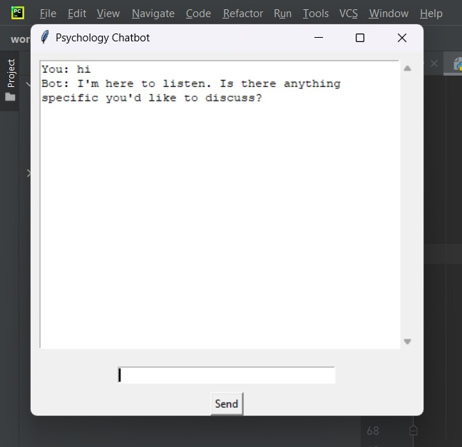
Preliminary Design

Slide 7
Methodology
Problem Statement :Creating a basic psychology chatbot that interacts with a user.
Libraries and Frameworks: Tkinter- Python's standard GUI toolkit for creating the user interface.
NLTK (Natural Language Toolkit):-A library for natural language processing, although this code only uses a basic pattern-matching approach from NLTK.
GUI Structure (Class-Based Design): It defines a class named PsychologyChatbotGUI that represents the main class for the chatbot's graphical interface.
Message Handling:Retrieving user input, Displaying the user message, Generating a chatbot response,Displaying the bot response & Clearing input.
Execution:When the code is executed, it creates an interactive chatbot window.

Slide 8
Analysis of Features
Initial Support and Triage:
The chatbot can provide preliminary support, such as offering resources, directing users to professional help, or suggesting coping mechanisms.
It can serve as a triage tool, helping users identify potential concerns and navigate towards appropriate resources.
Low-Barrier Interaction:
The text-based interface can feel less intimidating for individuals who might struggle with expressing themselves verbally.
This can be particularly beneficial for those experiencing social anxiety or discomfort with face-to-face interactions.

